Slide 1
Microsoft Power Platform + Dynamics 365
Notes:
Hi, Welcome to Microsoft Power Platform + Dynamics 365 Bootcamp.

Slide 2
Course Overview
Day 1
Empowering Everyone with Power Platform – From CEO to Frontline Workers
Introduction to Power Platform
Day 2
Power Packed Day with Power Canvas Apps
Introduction to PowerApps
Day 3
Power Packed Day with Power Model Driven Apps
Let’s talk about data
Day 4
Power Packed Day with Power Automate
Introduction
Day 5
Power Packed Day with Power Virtual Agents
Introduction
Microsoft Power Platform momentum
Why Power Platform?
Customer Stories
Demo
Benefits of PowerApps
What can I build with PowerApps?
Types of PowerApps
Canvas Apps
Data Sources and Connectors
Demo
Types of flow
Data types and expression
Working with Arrays
Control flow and action settings
Demo
Types of Data
Common Data Service
Model-driven Apps
What type of components can I add?
Data model design
Demo
A Robust Virtual Agent Platform
Converse everywhere
Easily make your bots better
Create personalized customer experiences
Transfer to a human agent
Built on Power Platform & Azure Bot Service
Extend your bot capabilities with Azure Bot Service
Demo

Slide 3
Continue…
Day 6
Power Packed Day with Power BI
Introduction
Day 7
Power up your Apps with AI Builder
Introduction
Day 8
Power Platform Administration, Security & Integration Connectors
Introduction
Day 9
Power Packed Bizz Apps Day – Sales & Marketing
Introduction
Day 10
Power Packed Bizz Apps Day– Finance & Supply Chain
Introduction
AI for every app. And everyone
Setup Environment
Types of AI Model
Prediction
Form processing
Object detection
Text classification
Demo
The 5x5 Principle
Customer momentum: Power BI
Power BI Desktop
Data sources
Power Query
Dataflow
Using a Calculation (DAX) in multiple files
Paginated Reporting
Power BI Admin Portal
Demo
Secure your tenant
Monitor your tenant’s activity
Alert & act on that activity
Connectors
SharePoint Integration
Demo
Nurture more demand
Personalize buyer experiences
Build relationships at scale
Make insight-driven decisions
Demo
How to embed Power BI in Dynamics 365 for Sales and Marketing
Technology Modernization
Modern Finance
Supporting modern supply chain management
Demo
How to embed Power Platform in Dynamics 365 for Finance and Supply Chain

Slide 4
Day 9: Power Packed Bizz Apps Day – Sales & Marketing

Slide 5

Agenda
Introduction
Nurture more demand
Personalize buyer experiences
Build relationships at scale
Make insight-driven decisions
Demo
How to embed Power BI in Dynamics 365 for Sales and Marketing

Slide 6



Dynamics 365
The world’s connected AI business cloud
Sales
Talent
Marketing
Finance
Service
Supply Chain
Commerce
Project Service Automation
Power Platform

Slide 7
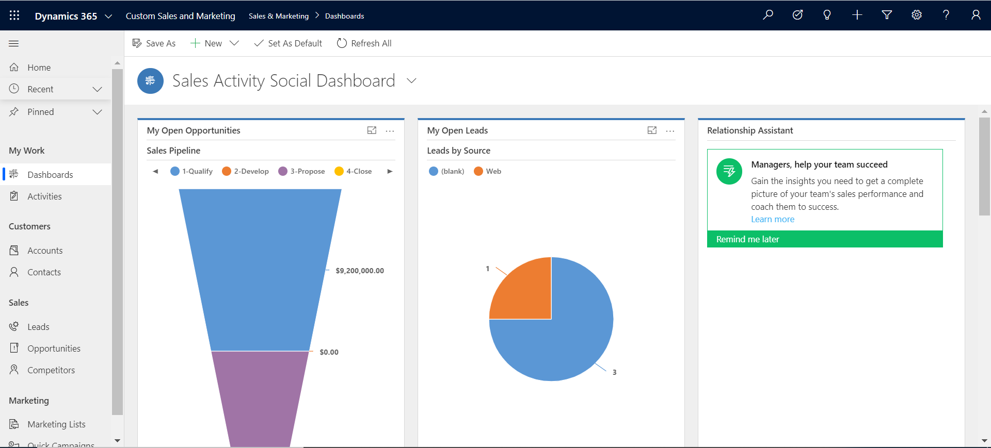
Dynamics 365 Dashboard

Slide 8
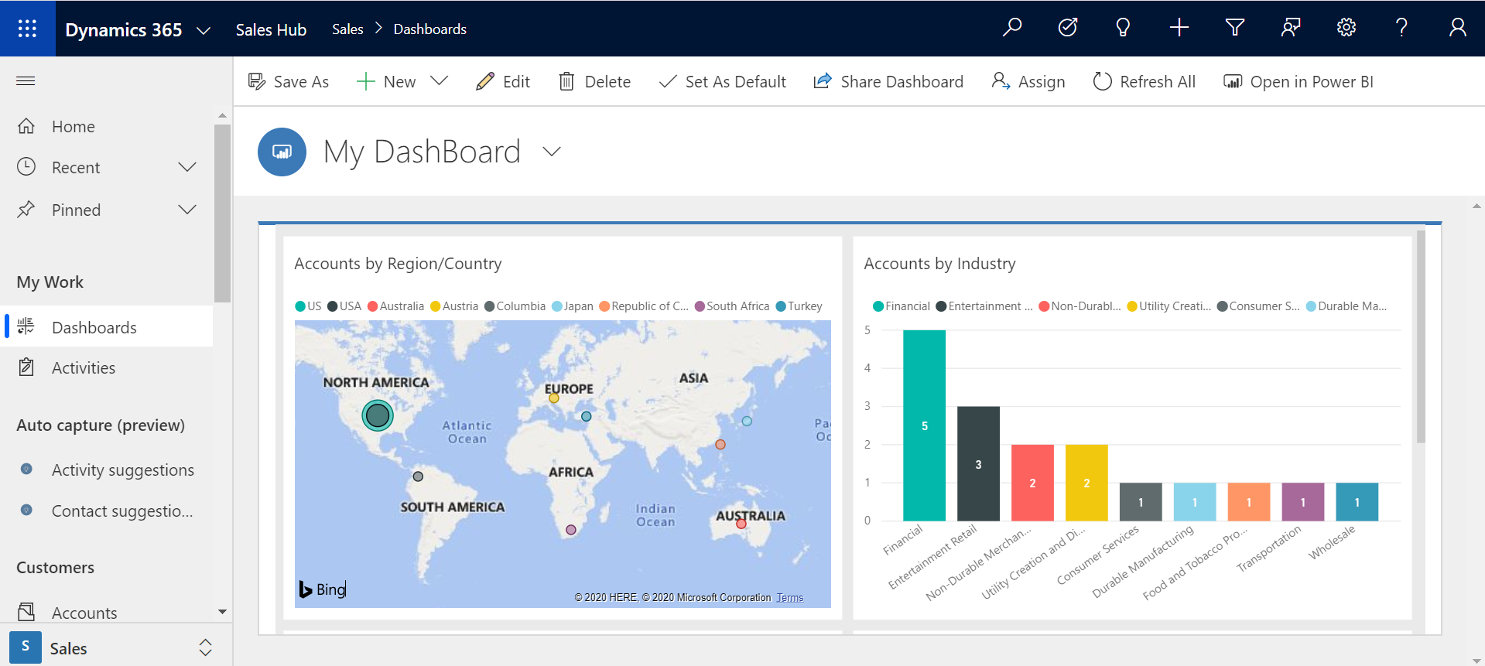
Power BI Dashboard in Dynamics 365

Slide 9
Research
Discover relevant news and insights
Stay on top of essentials
Email alerts
Track and prioritize leads
Multiple lead-scoring models
Sales readiness grades
Smart scheduling
Handoff to sales
Pre-made workflows
Unified data across contacts, leads, and customers
Campaign asset creation
Emails
Web landing pages
Event management
Social media integration
Dismiss lead
Lead scoring
Predictive lead scoring and prioritization models
Nurture leads
Personalized, account-based content
Customer journey designer
A/B testing
Dynamic segmentation
Customer interaction insights
Surveys
Customer interactions
Warm introductions
Recommended, personalized talking points and actions
AI-driven next best actions
Personalized sales documents
Showcase product with mixed reality
Customer Data Platform
Data ingestion
Data unification
AI-driven segmentation
Intelligent Sales & Marketing
Manage relationships
Relationship assistant
Health and risk scores
Interactive org charts
Positive outcome
Actionable insights
Supervisor review
Pipeline analysis
Relationship and conversational intelligence
Coaching and training opportunities
Data capture
Win deal
Document sharing
Leveraging winning sales techniques
Negative outcome
Survey distribution
Automated, personalized surveys

Slide 10
Research
Discover relevant news and insights
Stay on top of essentials
Email alerts
Track and prioritize leads
Multiple lead-scoring models
Sales readiness grades
Smart scheduling
Campaign asset creation
Emails
Web landing pages
Event management
LinkedIn integration
Social media integration
Nurture leads
Personalized, account-based content
Customer journey designer
A/B testing
Dynamic segmentation
Customer interaction insights
Surveys
Customer Data Platform
Data ingestion
Data unification
AI-driven segmentation
Nurture more demand

Slide 11


Build richer, more holistic views of your customers, unlock insights and take action
Create emails, landing pages and event web portals that display content personalized for contacts.
Discover, track, and quickly react to key events, trends, and indicators that are most relevant to your business
Create and customize multi-channels campaigns specifically for your audience
Track and prioritize leads across all touchpoints with multiple lead-scoring models and sales readiness grades
Nurture more demand

Slide 12
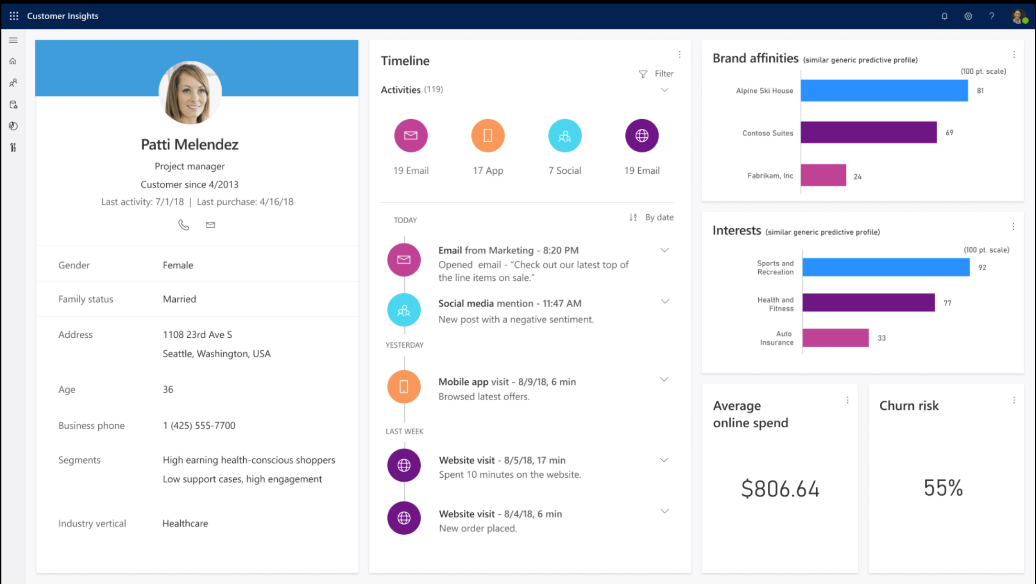
Customer Data Platform
Dynamics 365 Customer insights:
Gain a holistic view of your customers
Bring together all your transactional, observational, and behavioral data for consumers and enterprises to get a holistic view of customers
Build powerful 360-degree contact profiles on top of rich pools of customer data with AI and intelligence from Microsoft Graph
Use an intuitive and flexible customer data platform (CDP) to unlock insights and power personalized customer experiences
Employ quick-start ML templates to predict churn or the next best action
Get next best actions and discover new audience segments with AI-driven recommendations

Slide 13
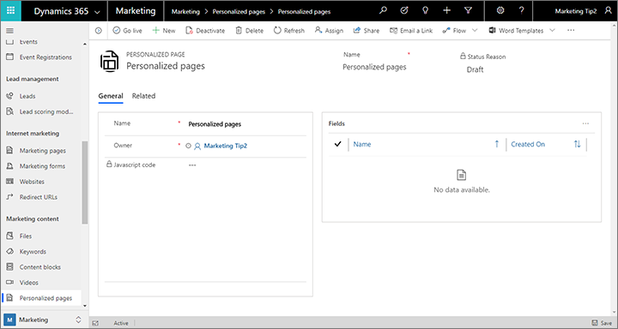
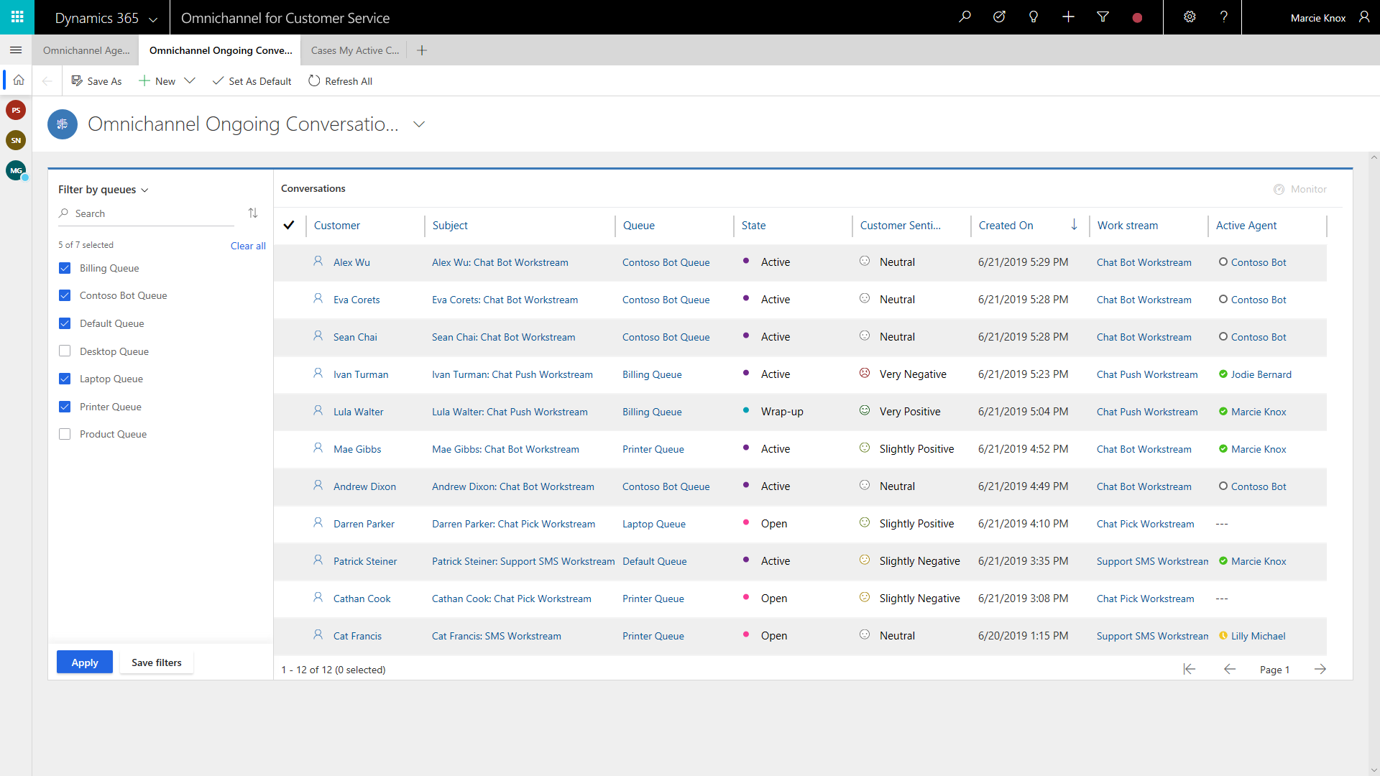
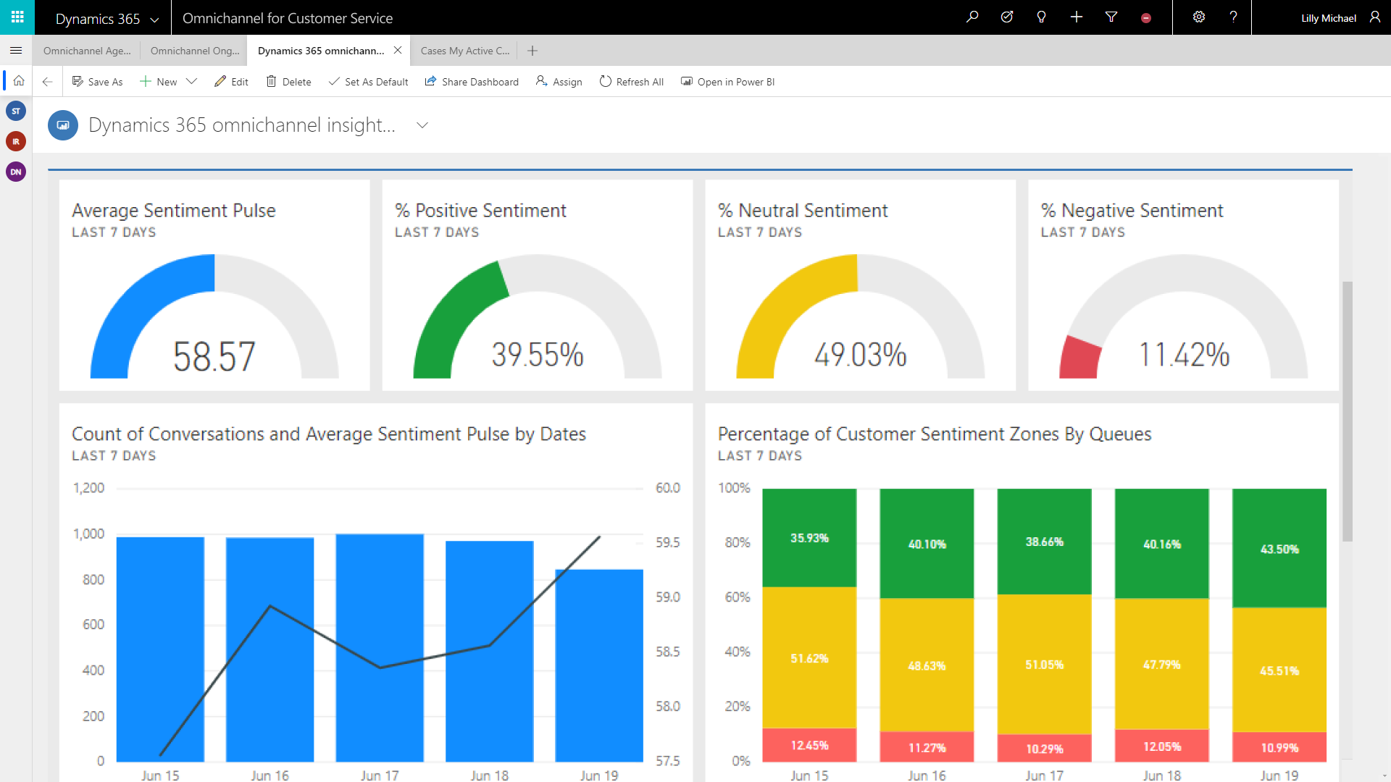
Campaign asset creation
Dynamics 365 Marketing:
Personalized page content
Develop websites with personalized layouts, dynamic content, branding, and more for each prospect based on their attributes and past behavior.
Known contacts can be identified by a cookie set on their browser that links to a contact record.
Create personalized pages by establishing the white list of contact fields, generating JavaScript code, and importing field values onto your page.
Add personalized content using HTML and edit the page in your CMS system with any text or code editor.

Slide 14
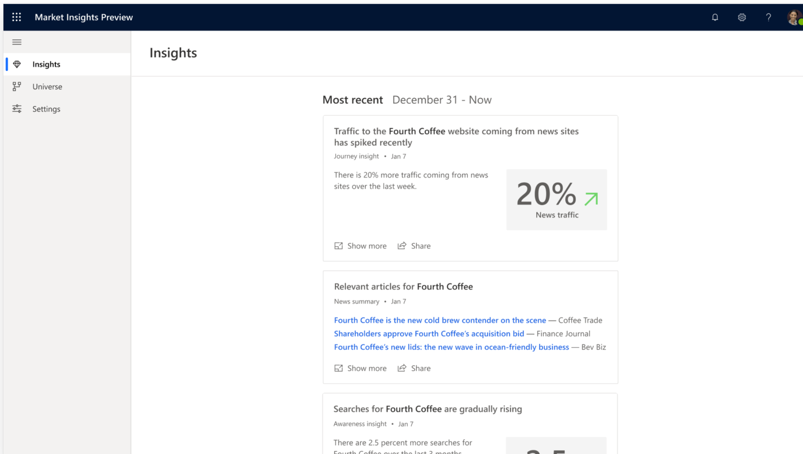
Research
Dynamics 365 Market Insights:
Identify and act on market trends
Discover, track, and quickly react to key events, trends, and indicators that are most relevant to your business
Keep up to date with AI-curated insights about the customers, competitors, and products you care about
Better understand what people are searching for and saying about the products or companies you’re interested in
Rely on insights and news derived from Microsoft and other trusted, credible data sources

Slide 15
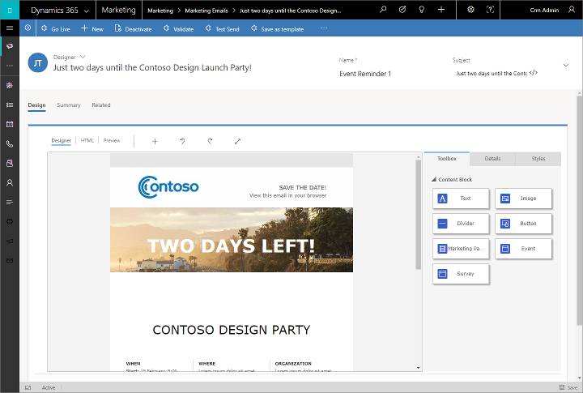
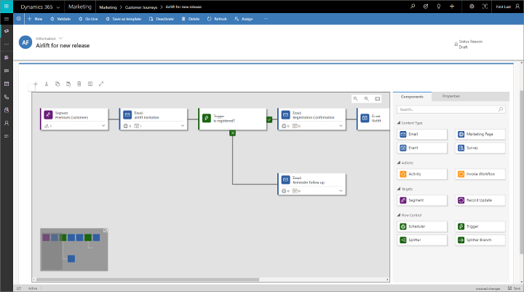
Nurture leads
Dynamics 365 Marketing:
Customize campaigns for your audience
Deliver and manage multichannel campaigns with automated communication, make automated decisions, generate internal tasks, follow up with communication, respond to customer interactions, and more
Use an embedded segmentation engine to set up sophisticated, dynamic marketing segments that target campaigns
With A/B testing, try each design on a different subset of the audience, and then analyze interaction records to see how each design was received.

Slide 16
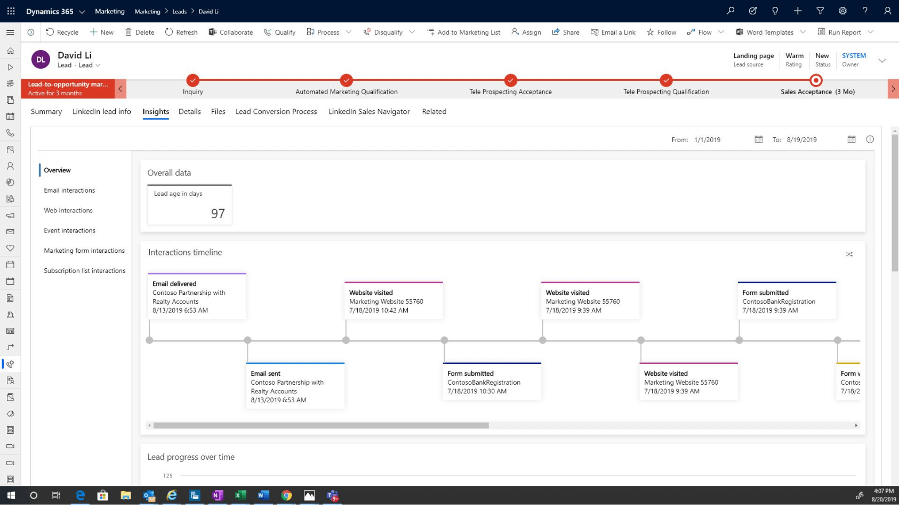
Track and prioritize leads
Dynamics 365 Marketing:
Track and prioritize leads across all touchpoints
See a single view of the customer with Dynamics 365 Sales to unify data across contacts, leads, and customers
Track and prioritize leads across all touch points with multiple lead-scoring models and sales readiness grades. Lead scoring helps you determine when a lead may be ready to become a prospect
Track campaigns and analyze results to build profitable, long-term relationships.
Take advantage of familiar Office 365 tools, shared calendars, and cross-team visibility into campaigns and leads. Easily set up and view campaigns with marketing calendars showing campaign timelines and activities.

Slide 17
Handoff to sales
Pre-made workflows
Unified data across contacts, leads, and customers
Dismiss lead
PERsonalized buyer experiences &
Build relationships at scale
Lead scoring
Predictive lead scoring and prioritization models
Customer interactions
Warm introductions
Recommended, personalized talking points and actions
AI-driven next best actions
Personalized sales documents
Showcase product with mixed reality
Manage relationships
Relationship assistant
Health and risk scores
Interactive org charts
Win deal
Document sharing
Leveraging winning sales techniques

Slide 18


Improve conversion and win rates with lead and opportunity scoring based on advanced scoring models
Enable smart selling with actionable insights and AI-driven next best action recommendations
Enhance sales productivity, find stakeholders & decision-makers with connected tools
Enhance buying and sales experience by showcasing products with mixed-reality
Personalize buyer experiences
& Build relationship at scale

Slide 19
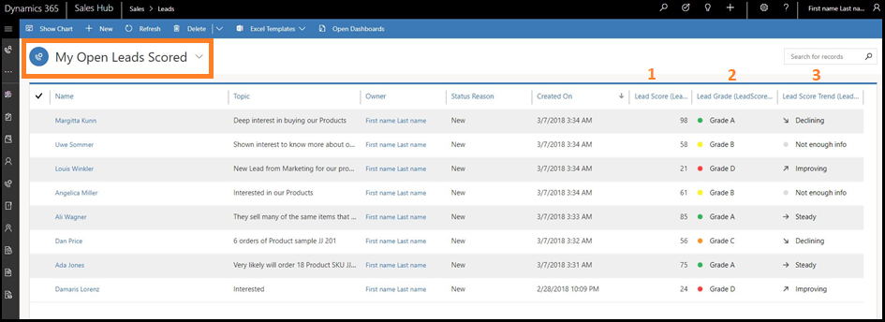
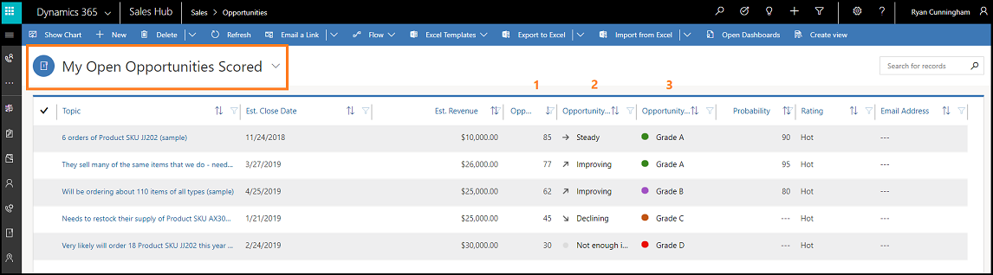
Lead scoring
Dynamics 365 Sales Insights:
Predictive scoring
Scoring model to generate scores and to identify and prioritize leads that have more chances of converting into opportunities
Provides a list of leads with different parameters including lead score, lead grade, and lead score trend
Get the list of opportunities with different parameters, including opportunity score, opportunity grade, and opportunity score trend
Predictive opportunity scoring model to focus sales efforts on opportunities that are more likely to convert into deals

Slide 20
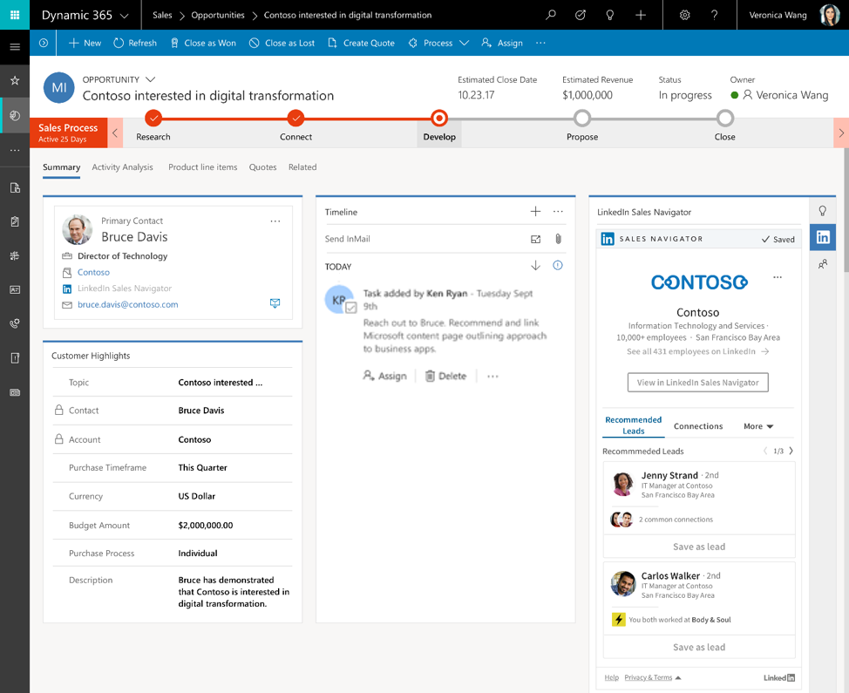
Customer interactions
LinkedIn Sales Navigator:
Understand your audience
Get profiles and data integrated in Dynamics 365 for Marketing, including related leads
Understand what customers are interested in through the content they share on LinkedIn
Receive alerts in real time when leads change jobs, connect with someone in their network, or are mentioned in the news
Get embedded insights that reveal the next best action based on a customer and their interaction data from LinkedIn, Dynamics 365, and Office 365
Send InMail, messages, and customized connection requests from Dynamics 365

Slide 21
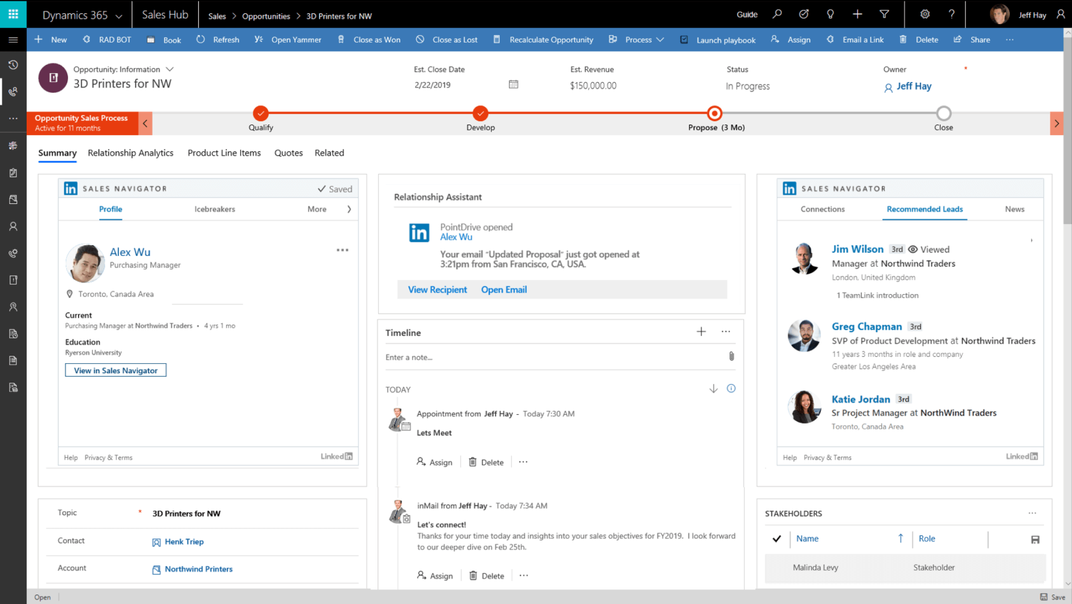
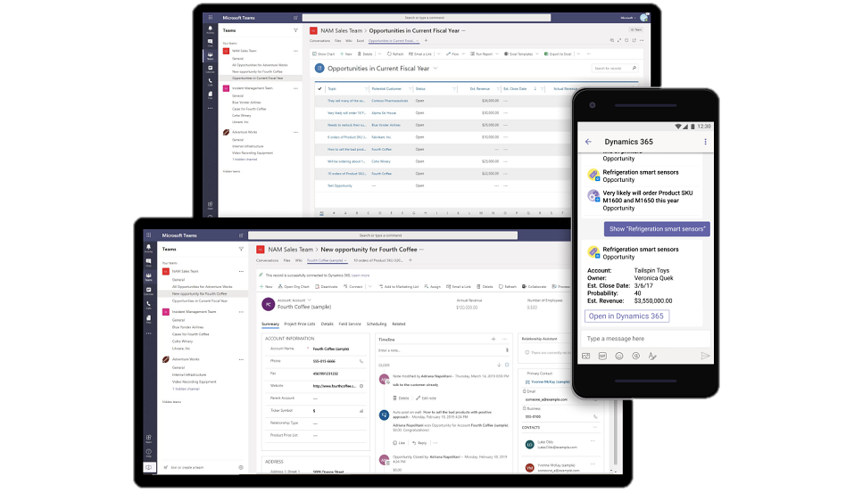
Customer interactions
Dynamics 365 Sales Insights and Teams:
Action recommendations
Use Assistant Studio to enforce best practices and guide sellers along a path to close deals faster and increase revenue
Get embedded insights that reveal the next best action to move sales relationships forward based on customer interaction data from LinkedIn, Dynamics 365, and Office 365
Analyze conversations across multiple channels with Conversation Intelligence to give sellers insights about how to improve over time
Even access your Sales Hub data and get action recommendations while you're on the go using Dynamics 365 Teams app on your mobile device

Slide 22
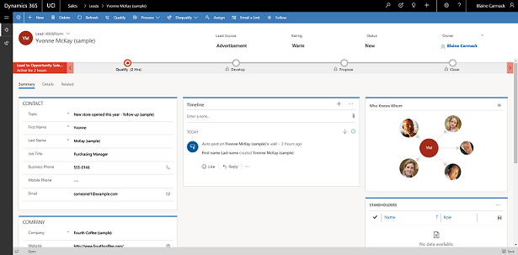
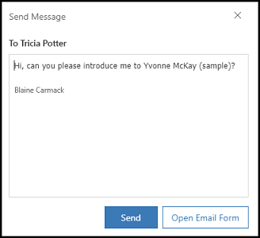
Customer interactions
Dynamics 365 Sales Insights:
Who Knows Whom
The Who Knows Whom features calculates relationships from the communication and collaboration patterns of users in your Microsoft Exchange environment
Provides you with details such as colleague names and email addresses who know the lead and can introduce leads or contacts
This feature is available in contact and lead forms. When you open a lead or contact and select the Sales Insights view, the Who Knows Whom tile is displayed
Increase sales performance to improve lead-to-opportunity conversion rates and help close more deals

Slide 23
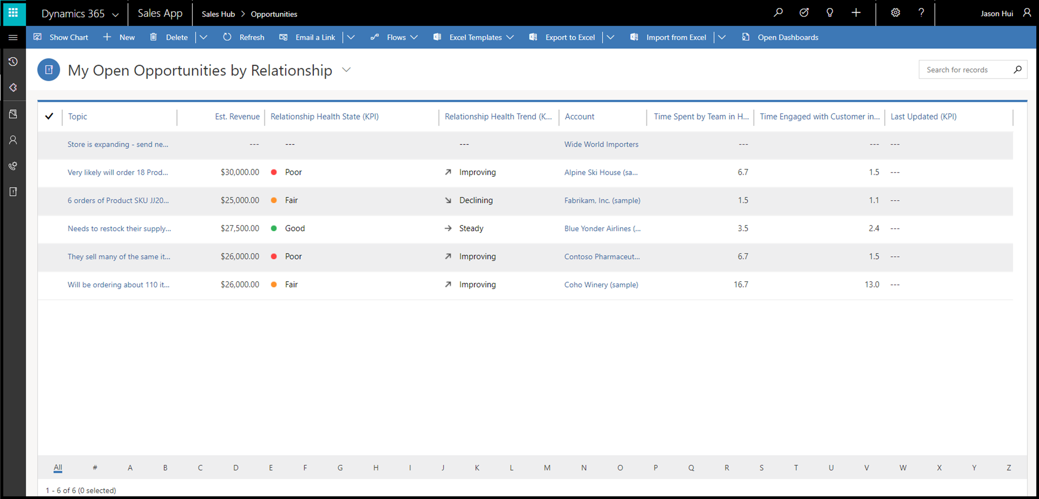
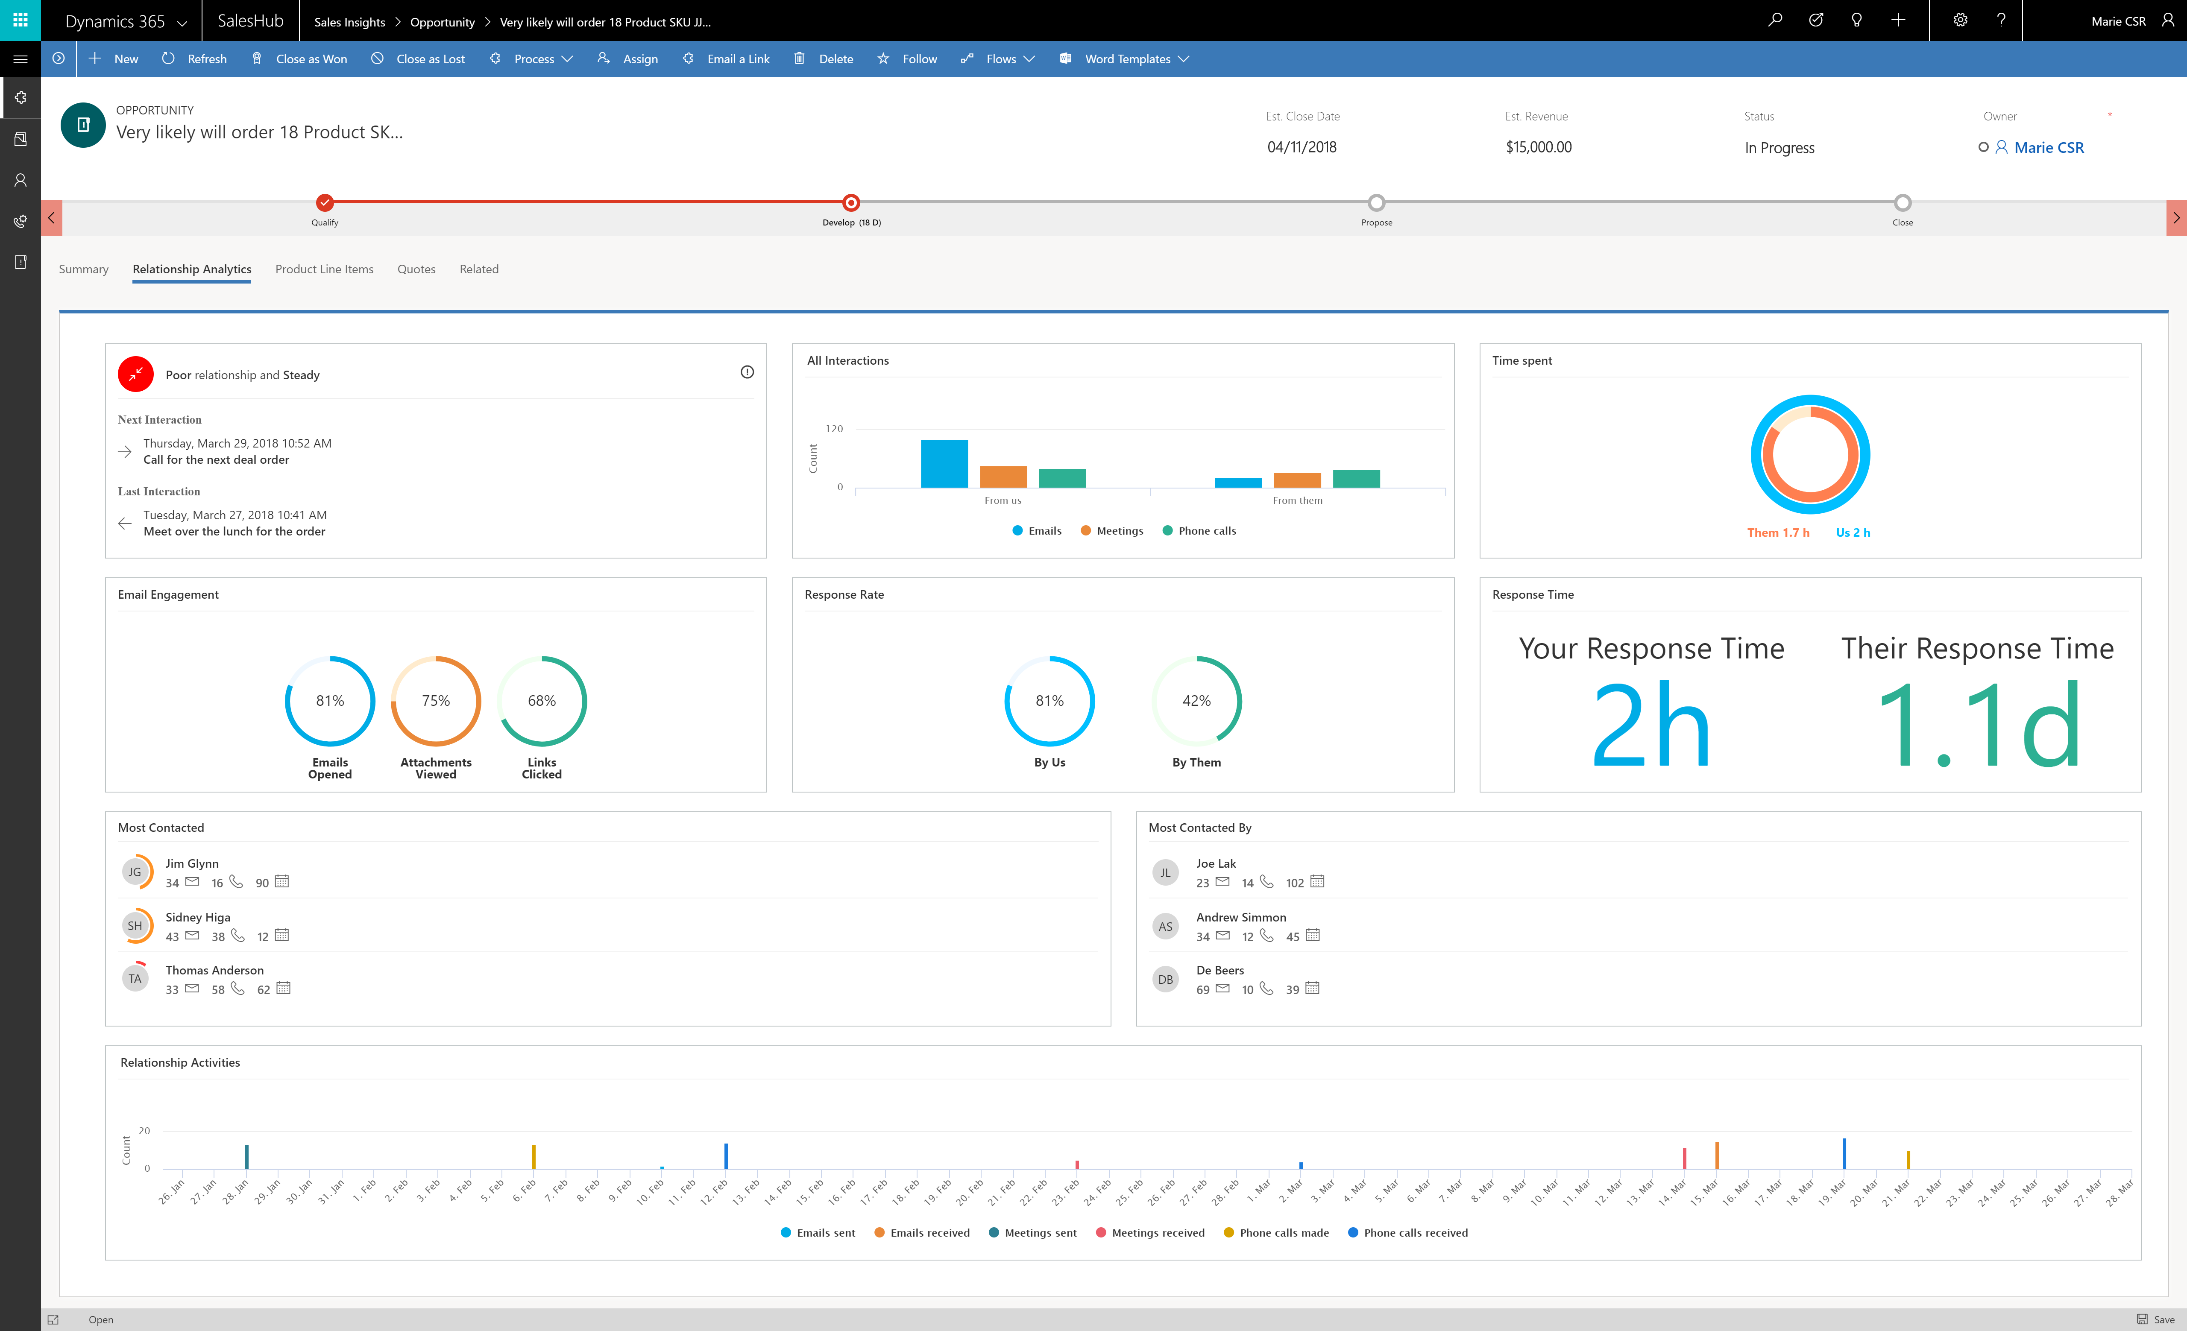
Manage Relationships
Dynamics 365 Sales Insights:
Relationship analytics
Assemble relevant information from a database to create a graphical display of KPIs, health scores, health trends, and activity histories for contact, opportunity, lead, and account records
The relationship pipeline view in form of a bubble chart displays health, close date, and estimated revenue for your upcoming opportunities

Slide 24
Make insights driveN decisions
Customer Data Platform
Data ingestion
Data unification
AI-driven segmentation
Positive outcome
Actionable insights
Supervisor review
Pipeline analysis
Relationship and conversational intelligence
Coaching and training opportunities
Data capture
Negative outcome
Survey distribution
Automated, personalized surveys

Slide 25


Understand customer needs and provide sellers with valuable feedback by creating and sending surveys to your customers
Learn from your sales calls with conversational intelligence: analyze customer emotion, sentiment, conversation content, and speaking style.
Increase sales performance and ramp sellers faster with AI-driven insights
Stay ahead of the market with insights that are derived from brand and competitor mentions.
Make insights driven decision

Slide 26
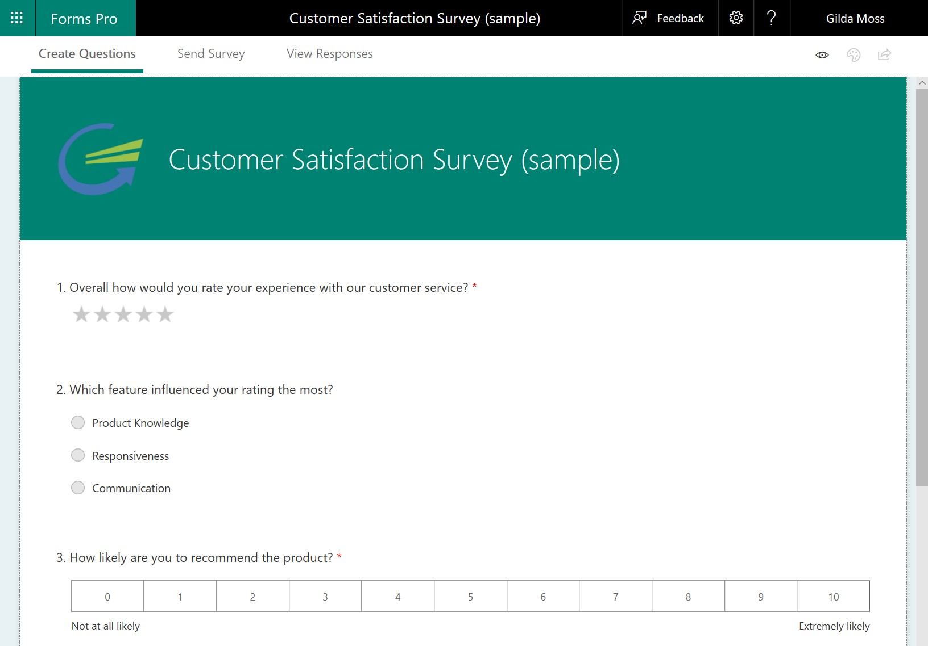
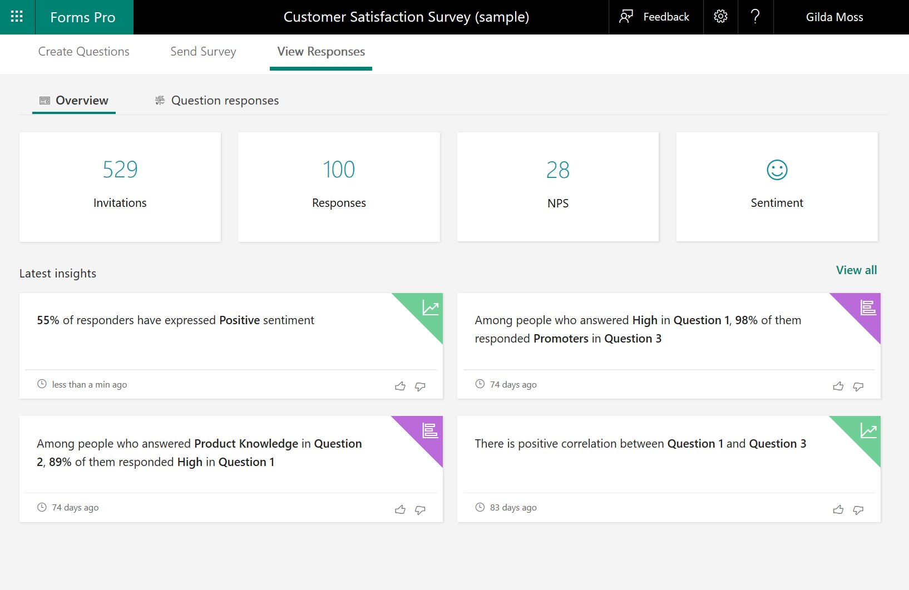
Surveys
Dynamics 365 Forms Pro:
Improve your sales process
Understand customer needs better and provide sellers with valuable feedback by creating and sending surveys to your customers
Distribute surveys by using email, Microsoft Flow, embedding it in web page, or generating a QR code
Leverage built-in analytics to evaluate responses or create custom analytics using Power BI

Slide 27
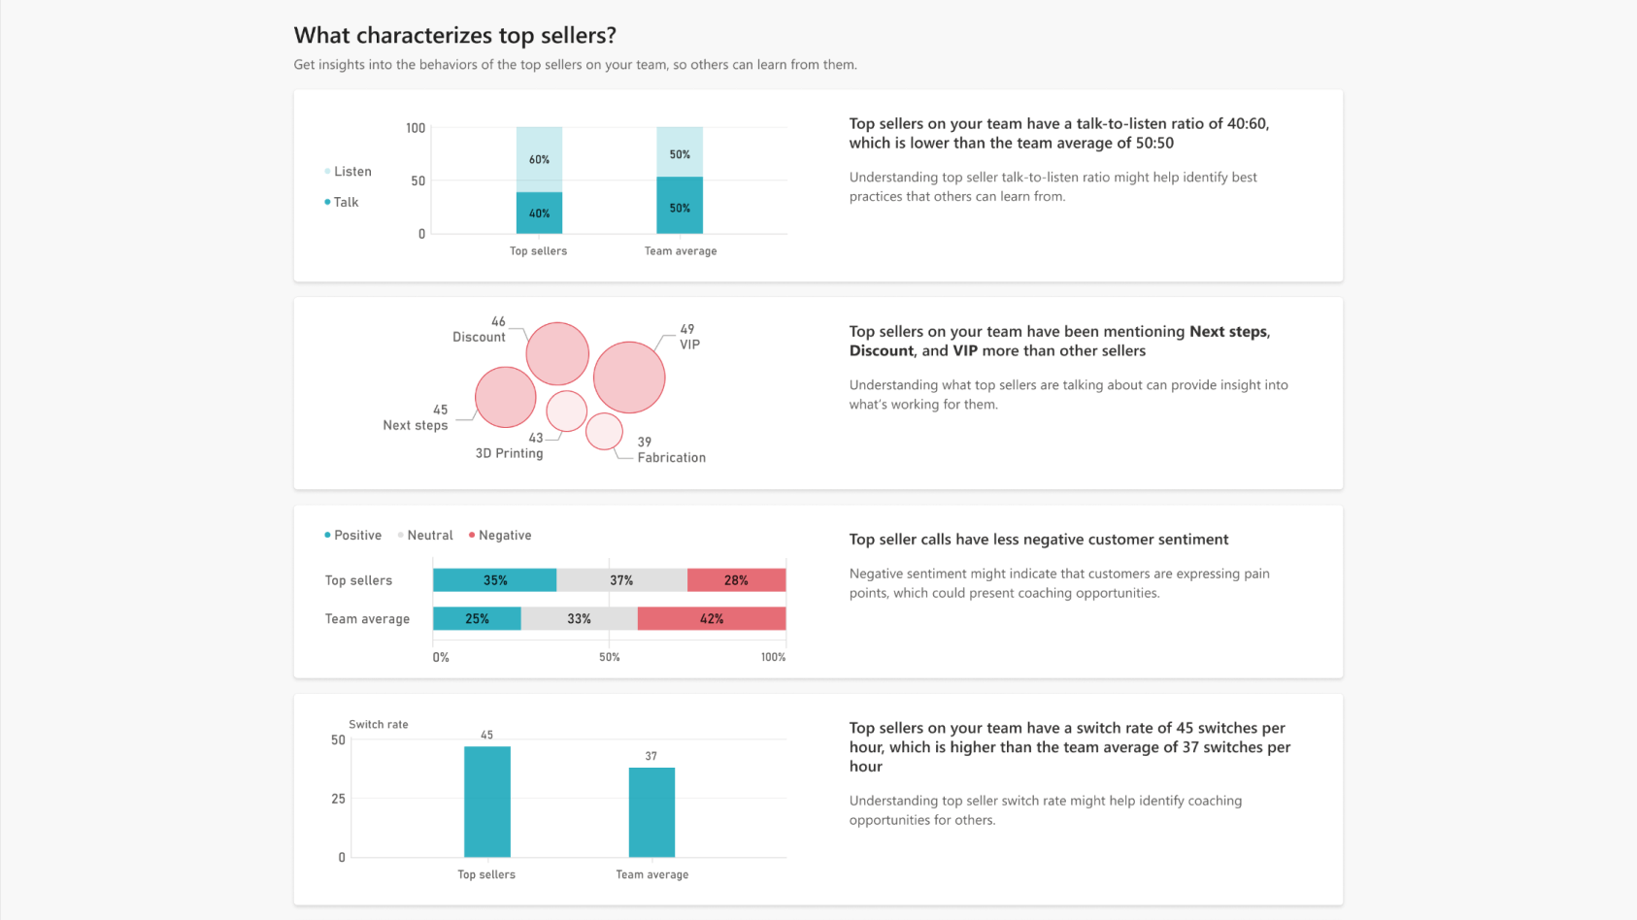
Actionable insights
Dynamics 365 Sales Insights:
Make strategic decisions
Conversation Intelligence analyzes conversations across multiple channels to give you insights about how to improve over time.
AI models for emotion detection offer granularity to give you a unique understanding of customer sentiments during calls.
Increase sales performance and ramp sellers faster with AI-driven insights that help busy sales leaders proactively flag at-risk deals, gain visibility into conversations, and provide actionable feedback through built-in coaching tools.
Stay ahead of the market with insights that are derived from brand and competitor mentions.

Slide 28
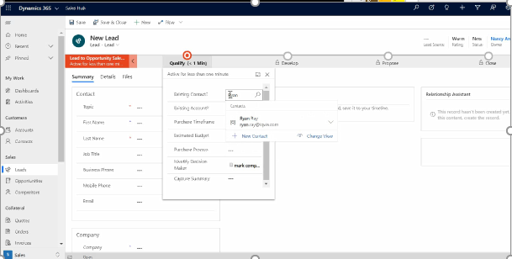
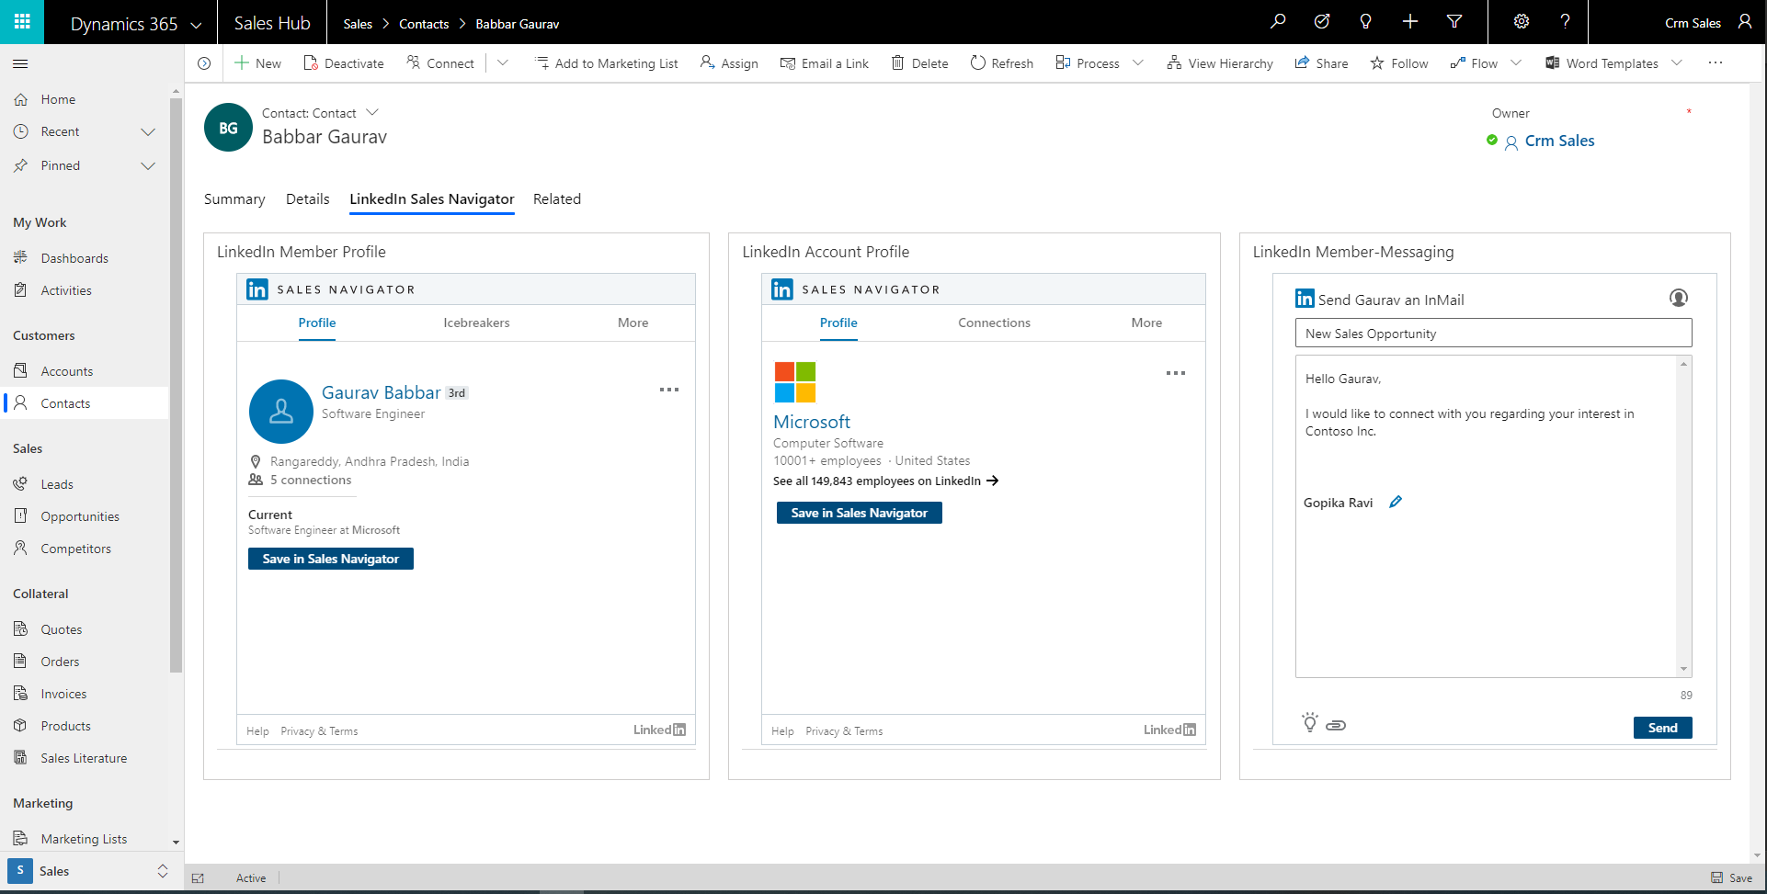
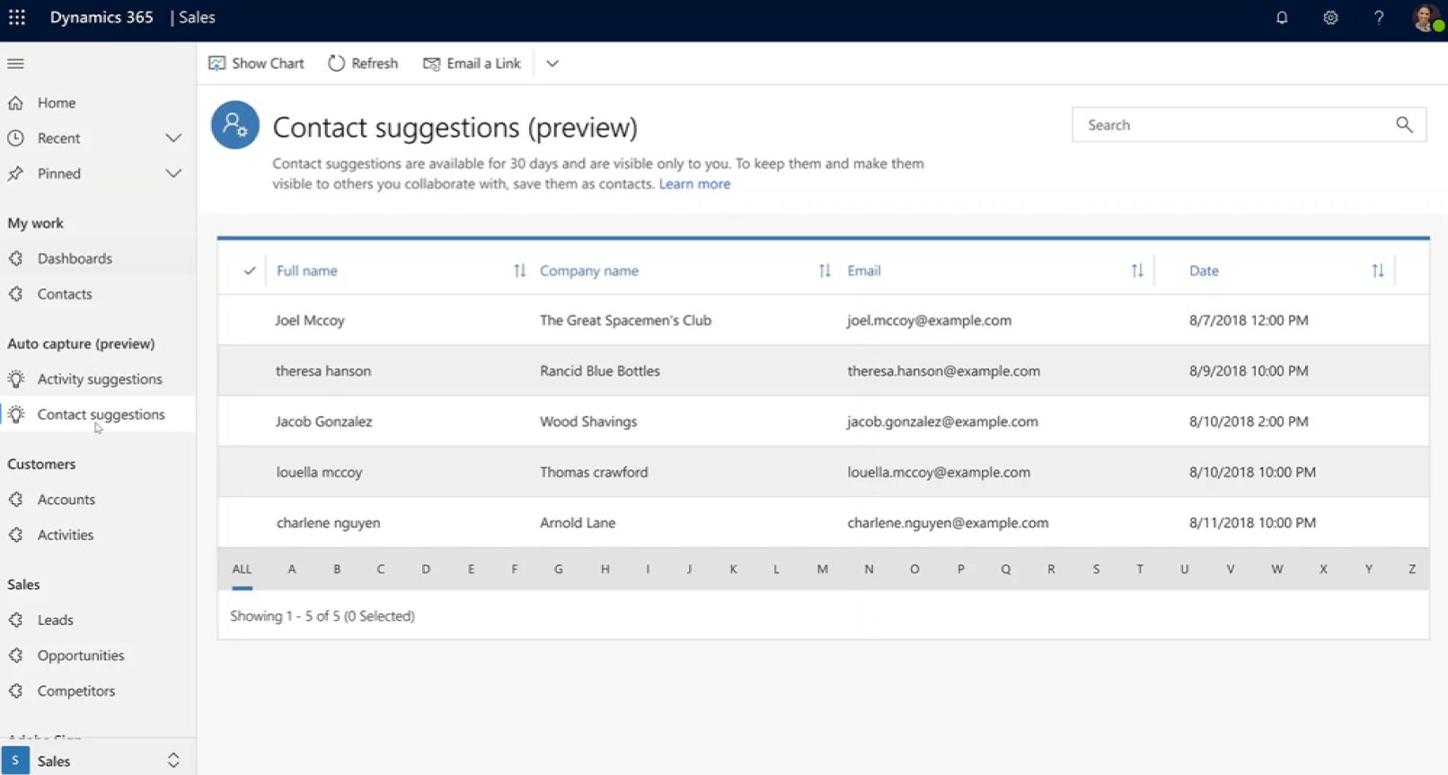
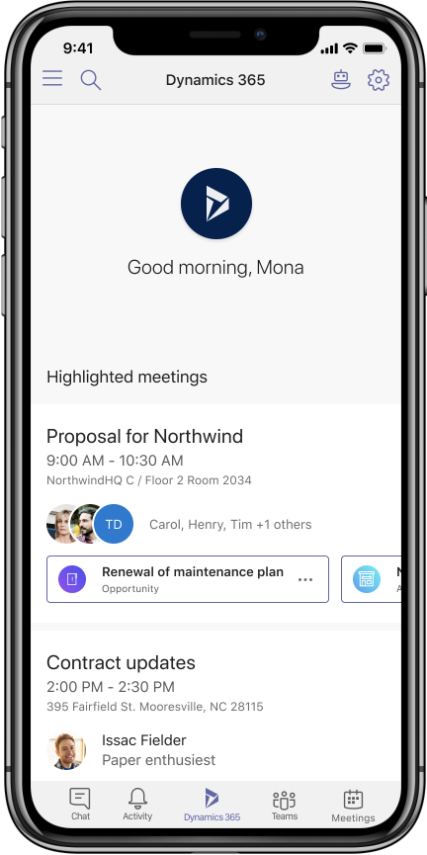
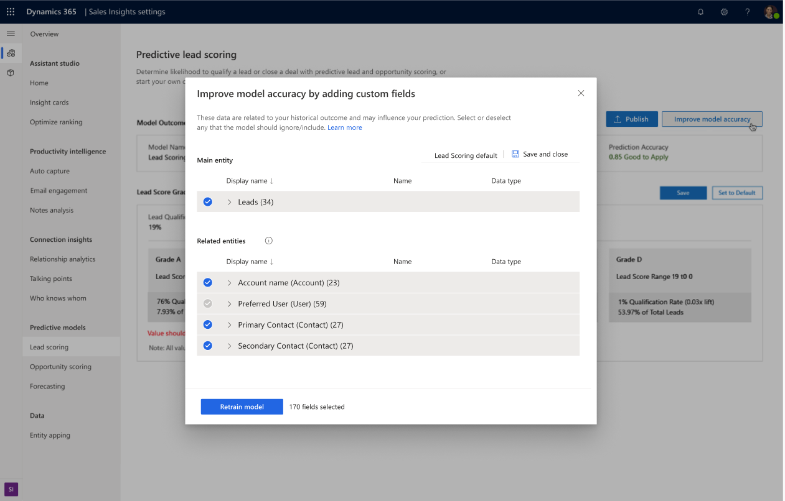
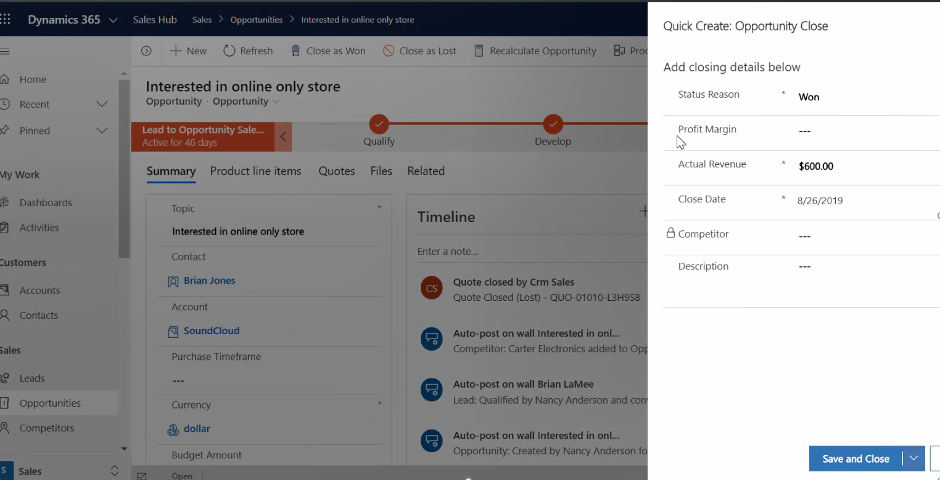
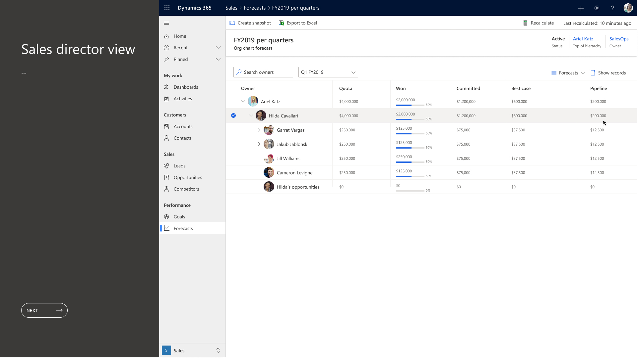

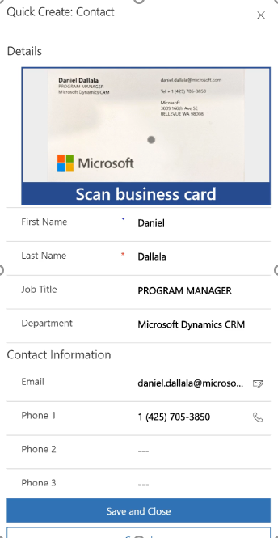
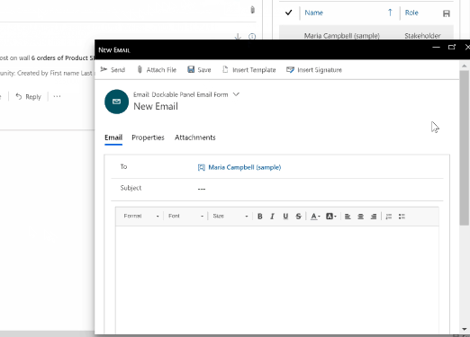
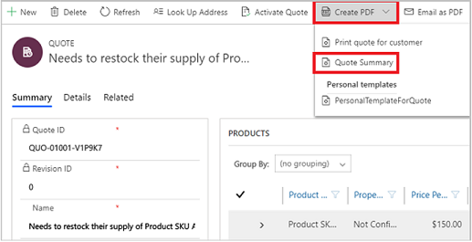
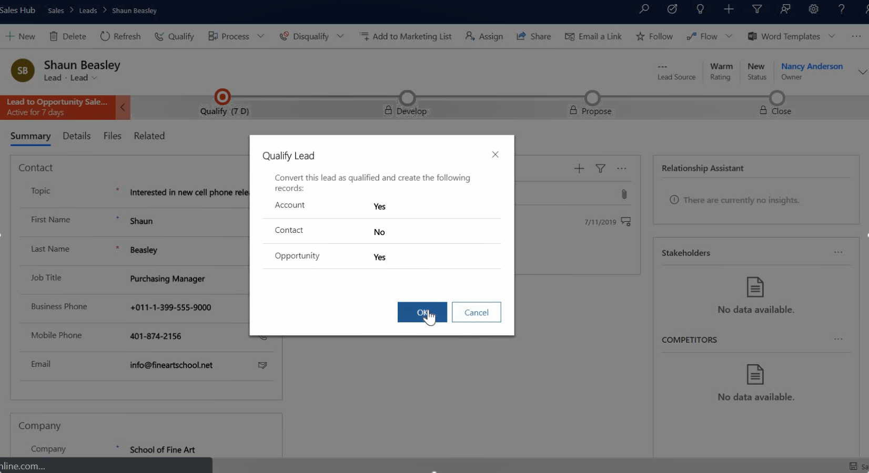
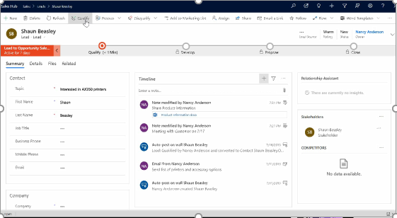
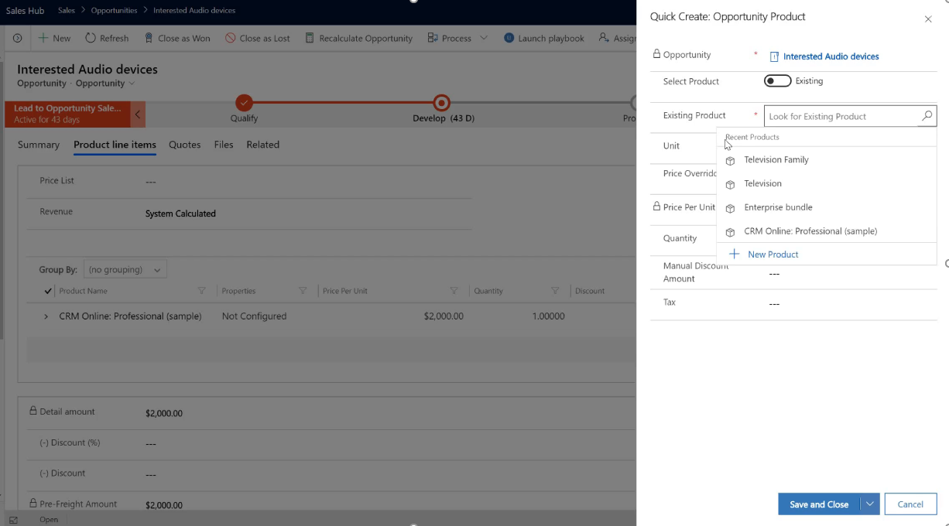
All new capabilities
Teams integration for better collaboration
Enter custom data, when closing an opportunity
Minimize data entry with auto populated fields in the lead form
Follow up on LinkedIn to deepen your relationships
Less data entry with auto capture
Prioritize using customized opportunity scoring
Forecast your results confidently
Lead
Qualify
Develop
Propose
Close
Assistant
Qualify leads with additional options
Write emails in context
View more detailed notes
Generate and send
PDFs for your quote
Assistant is your omnipresent help every step of the way
Add new products and price list items easier
Create new contacts quickly with business card scan
Available in Preview
Sales Insights partially required

Slide 29

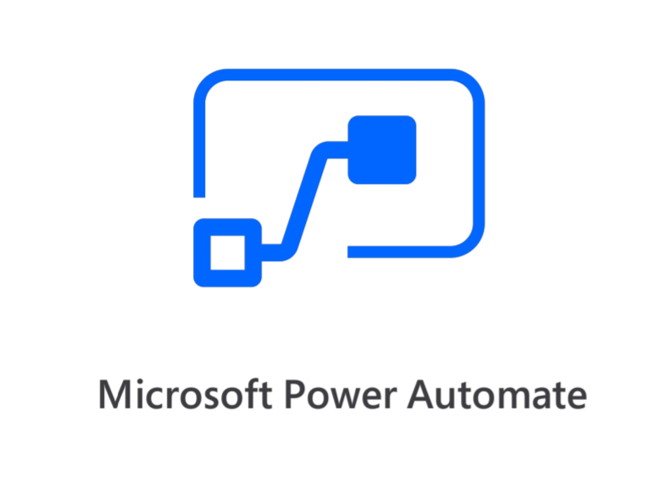






Extend with our ecosystem
200+ Partners, that provide connectors and apps, interesting ones for Sales include:

Slide 30

Demo
How to embed Power BI in Dynamics 365 for Sales and Marketing
Notes:
https://docs.microsoft.com/en-gb/powerapps/user/add-powerbi-dashboards
https://docs.microsoft.com/en-gb/powerapps/user/add-powerbi-dashboards#embed--power-bi-tiles-on-your-personal-dashboard

